Slide 1
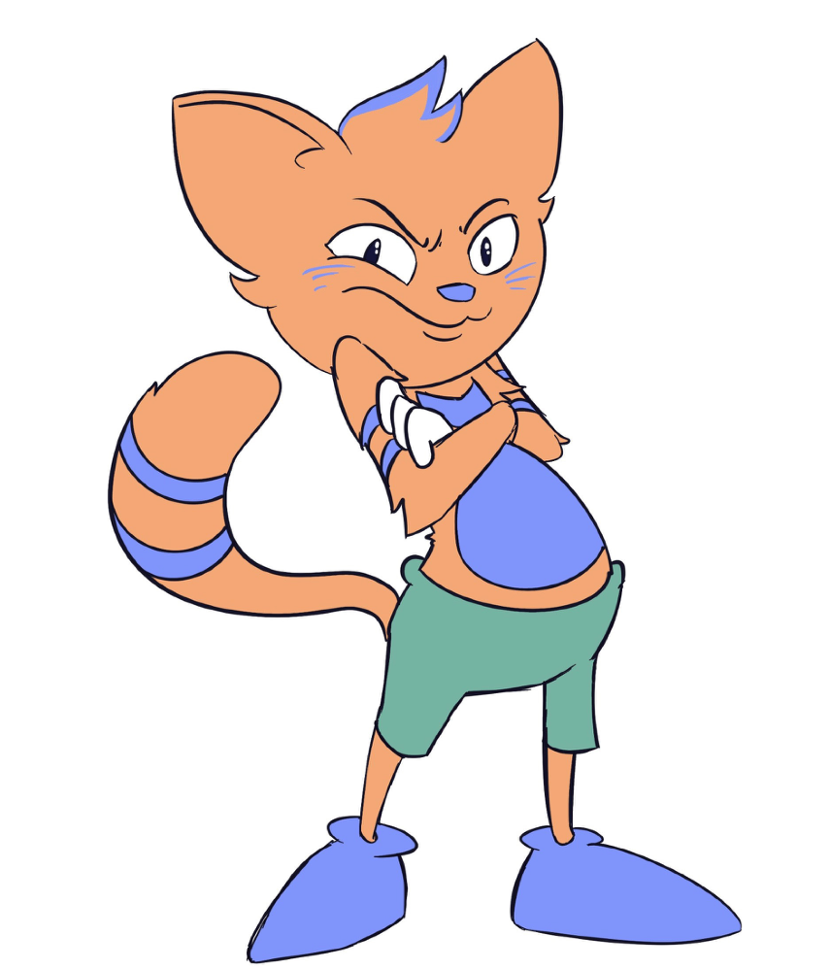
KINDERGARTEN - SECOND GRADE | INTEGRITY
BAD CHOICE
© 2022 OVERCOMING OBSTACLES

