Slide 1
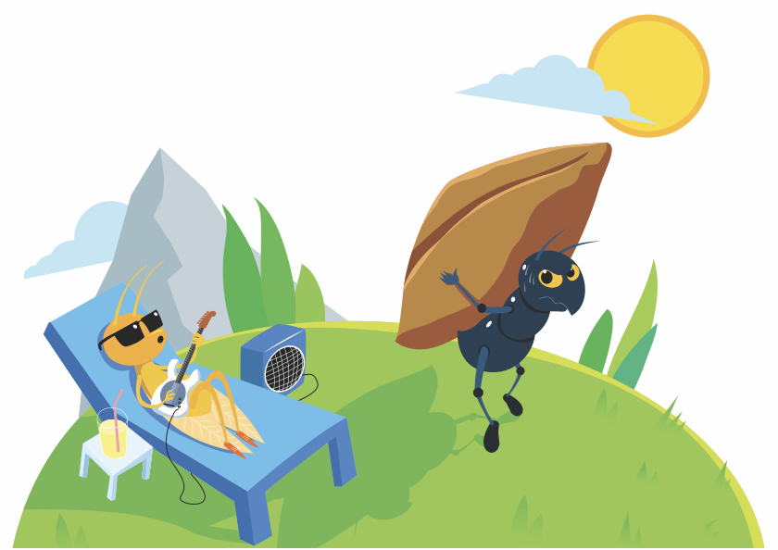
KINDERGARTEN - SECOND GRADE | BEING RESPONSIBLE
THE ANT AND THE GRASSHOPPER: AN AESOP FABLE
In a field one summer’s day, a Grasshopper was hopping about, chirping and singing to its heart’s content. An Ant passed by, bearing along with great toil an ear of corn he was taking to the nest.
“Why not come and chat with me,” said the Grasshopper, “instead of toiling and moiling in that way?”
“I am helping to lay up food for the winter,” said the Ant, “and recommend you do the same.”
“Why bother about winter?” said the Grasshopper. “We have got plenty of food at present.” But the Ant went on its way and continued its toil.
When the winter came, the Grasshopper had no food and found
itself dying of hunger—while it saw the ants distributing
every day corn and grain from the stores they
had collected in the summer. Then the Grasshopper
knew: it is best to prepare for days of need.
© 2022 OVERCOMING OBSTACLES

