Slide 1
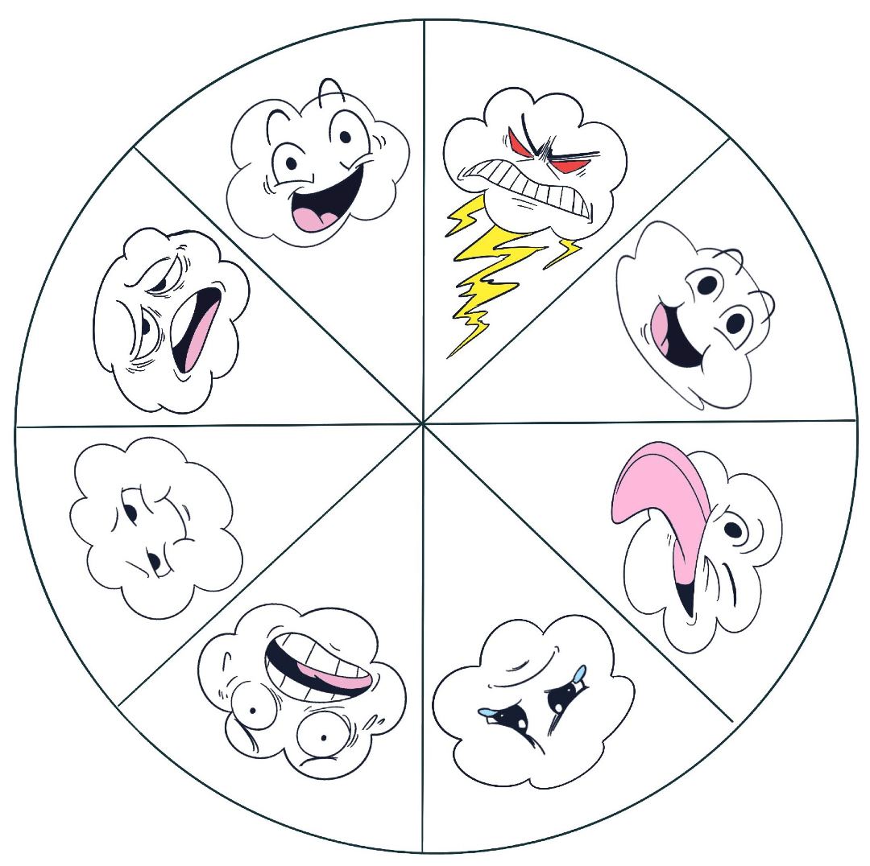
KINDERGARTEN - SECOND GRADE | FAIRNESS
WHEEL OF EMOTIONS
Today, I Feel…
EXCITED
ANGRY
TIRED
HAPPY
CALM
SILLY
© 2022 OVERCOMING OBSTACLES
SCARED
SAD

