Slide 1
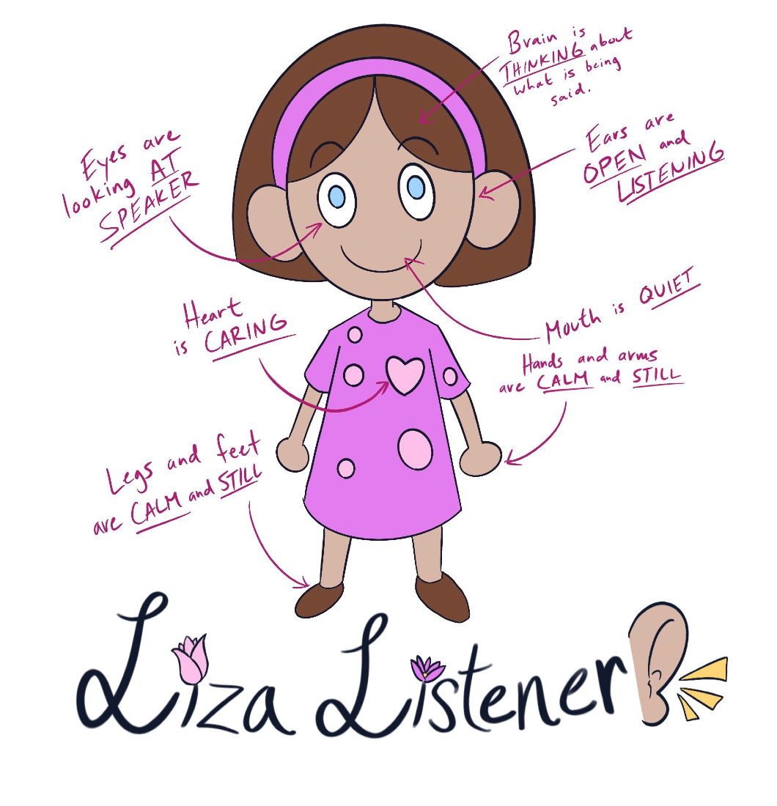
KINDERGARTEN - SECOND GRADE | LISTENING
WHOLE BODY LISTENING CHART
© 2022 OVERCOMING OBSTACLES

