Slide 1
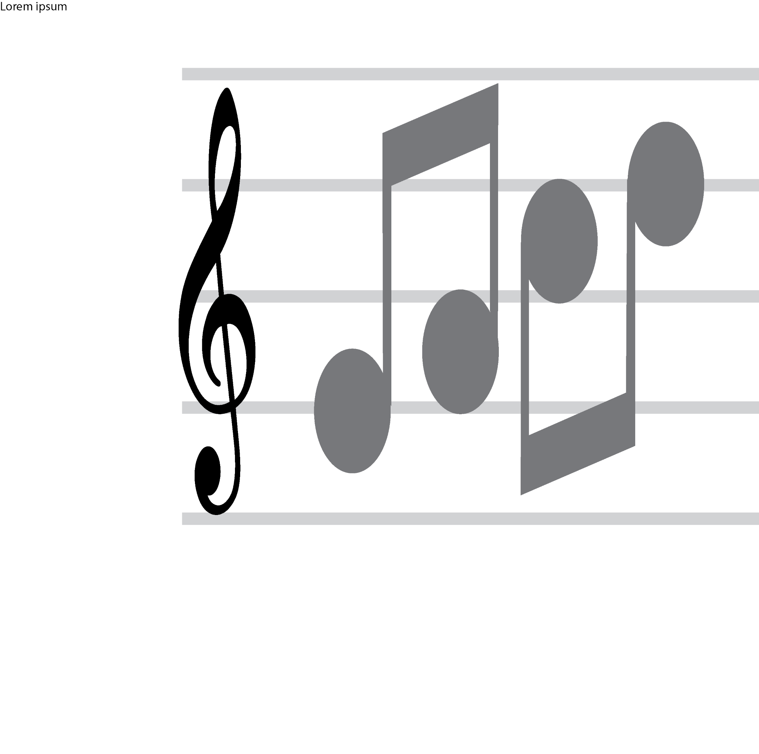
RESOLVING CONFLICTS | IDENTIFYING EMOTIONS IN CONFLICTS
SCALE OF EMOTIONS
angry
These are the emotions I feel in a situation where there is CONFLICT
These are the emotions I feel in a situation where there is FRUSTRATION
annoyed
These are the emotions I feel in a situation where there is CONFUSION
uncomfortable
These are the emotions I feel in a situation where there is PEACE
relaxed
© 2022 OVERCOMING OBSTACLES

