Slide 1
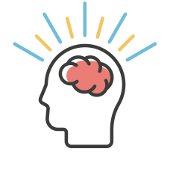
MANAGING YOUR LIFE | NURTURING THE DEVELOPMENT OF YOUNG CHILDREN
BRAIN PLASTICITY
Neuroplasticity (or brain plasticity) is the ability of the brain to change and adapt throughout a person’s life. Your brain’s plasticity is especially strong in the earliest years of your life.
AMOUNT OF EFFORT REQUIRED TO CHANGE
THE BRAIN’S ABILITY TO CHANGE
AGE
© 2022 OVERCOMING OBSTACLES
2 4 6 8 10 20 30 40 50 60 70

