Slide 1
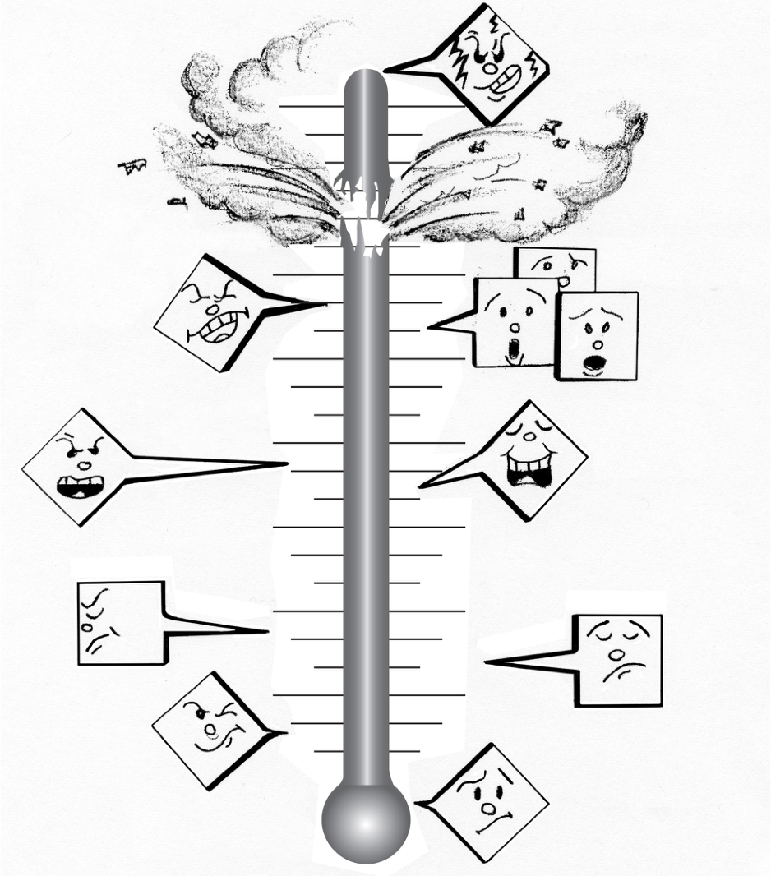
RESOLVING CONFLICTS | INTRODUCING CONFLICT RESOLUTION
THE STAGES OF CONFLICT
Conflict escalates into physical violence.
People involved can’t accurately describe their emotions; they can only say that they are angry..
Others outside the conflict get involved.
People stop listening. They being saying things they don’t mean.
People resort to criticisms and generalizations.
People are thinking only of their own goals and ignore the needs of others.
People stop trusting each other and grow suspicious.
Dialogue doesn’t seem to work–people begin to argue
People’s needs or wants clash.
© 2022 OVERCOMING OBSTACLES

