Slide 1
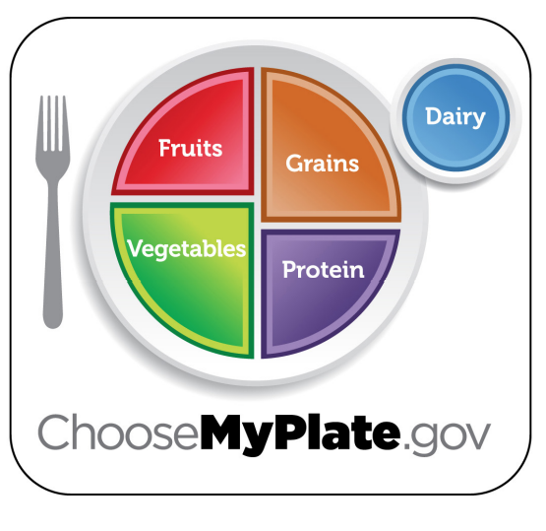
CONFIDENCE BUILDING | IMPROVING WELL-BEING
MYPLATE
© 2022 OVERCOMING OBSTACLES

