Slide 1
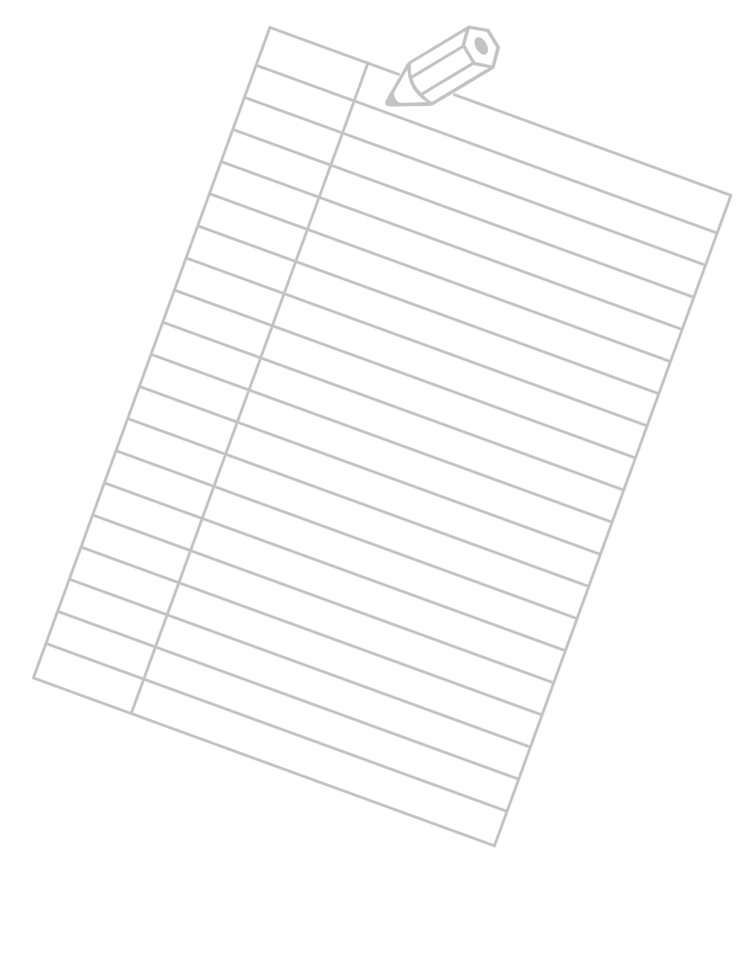
STUDYING EFFECTIVELY | FOLLOWING INSTRUCTIONS
TEST YOURSELF
Write your name in the top right corner of this paper.
Fold this paper in half the long way.
Unfold this paper.
Tear off the bottom left corner of this paper.
Write the word “up” to the right of this sentence.
Turn this paper upside down and write the word “down.”
Draw a circle and divide it into four parts.
Poke two holes in the middle of this paper.
Draw a line to connect the holes.
Ignore directions 3 through 9 on this paper.
© 2022 OVERCOMING OBSTACLES

