Slide 1
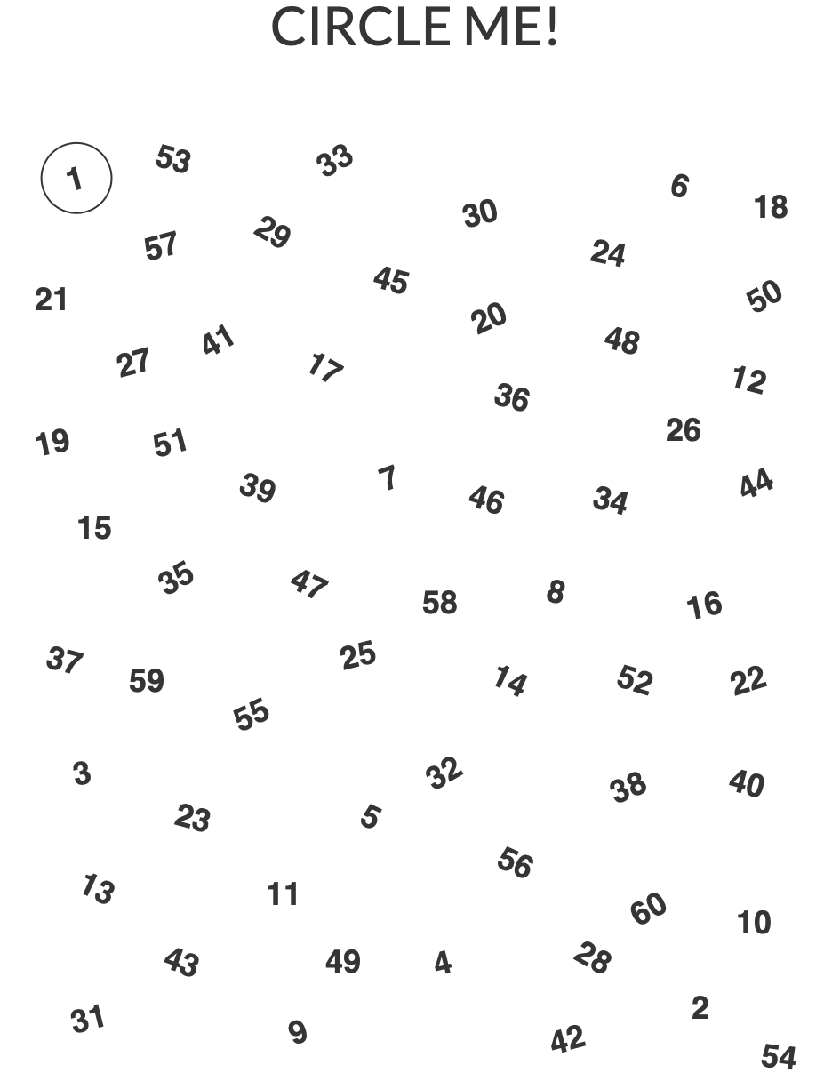
DECISION MAKING | MAKING A CHOICE
CIRCLE ME!
© 2022 OVERCOMING OBSTACLES

