Slide 1
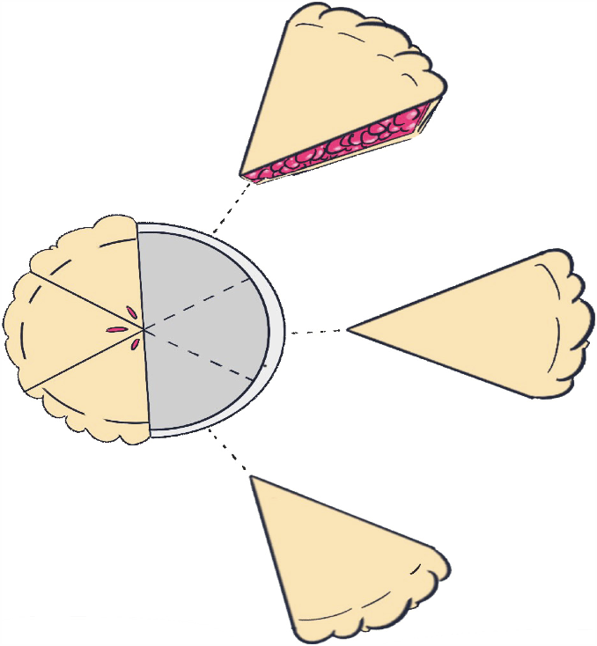
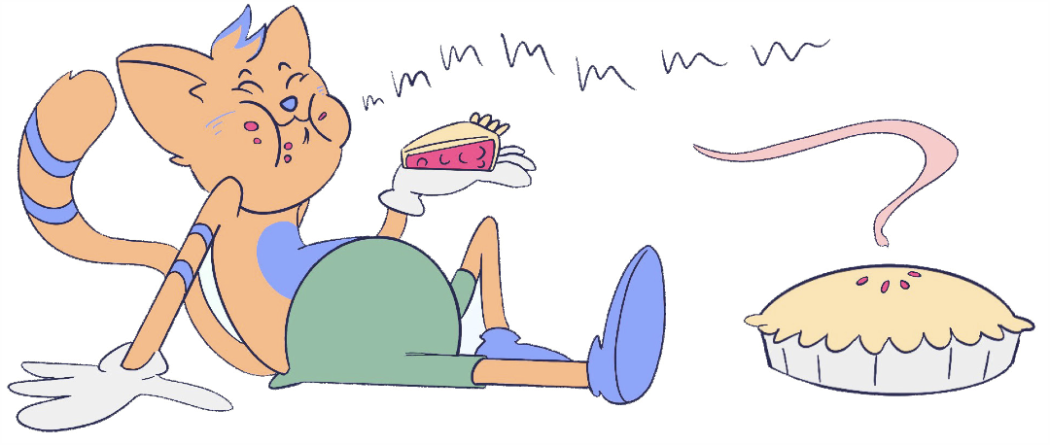
THIRD - FIFTH GRADE | BECOMING A GOOD FRIEND
ATTRIBUTE PIE
Example(s)
Example(s)
Example(s)
© 2022 OVERCOMING OBSTACLES

