Slide 1
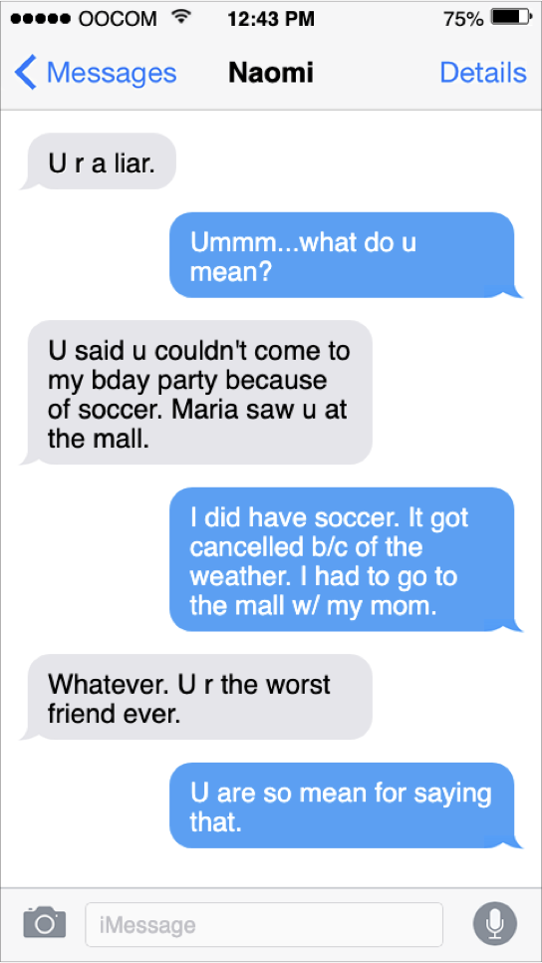
THIRD - FIFTH GRADE | RESOLVING CONFLICTS
SAMPLE “YOU-MESSAGE”
Read the text conversation between Naomi (messages in white)
and her friend (messages in blue).
How would you feel if you were Naomi’s friend?
© 2022 OVERCOMING OBSTACLES

