Slide 1
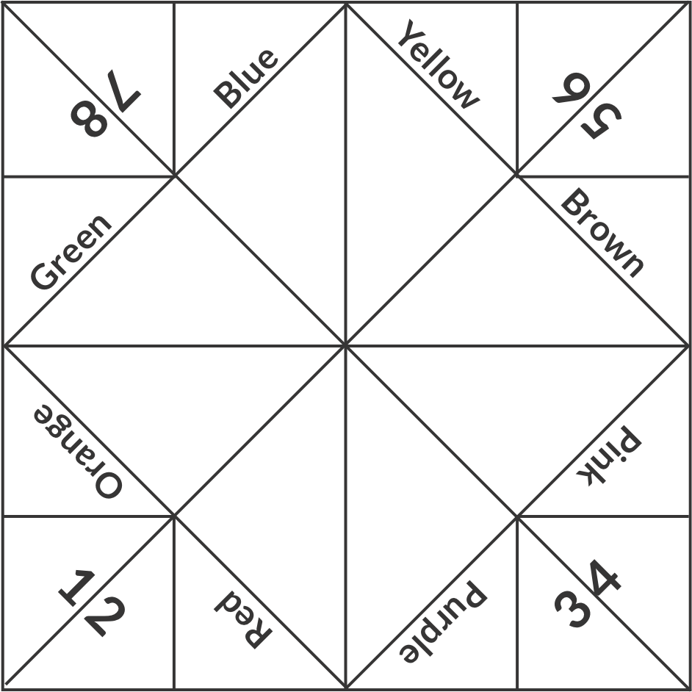
THIRD - FIFTH GRADE | RESOLVING CONFLICTS
CONFLICT RESOLUTION FORTUNE TELLER
Say
sorry
Share it!
Talk about it with someone
Get help or ask for advice
Take turns/ switch off
Compromise
Come to an agreement
Let things cool down
© 2022 OVERCOMING OBSTACLES

