Slide 1
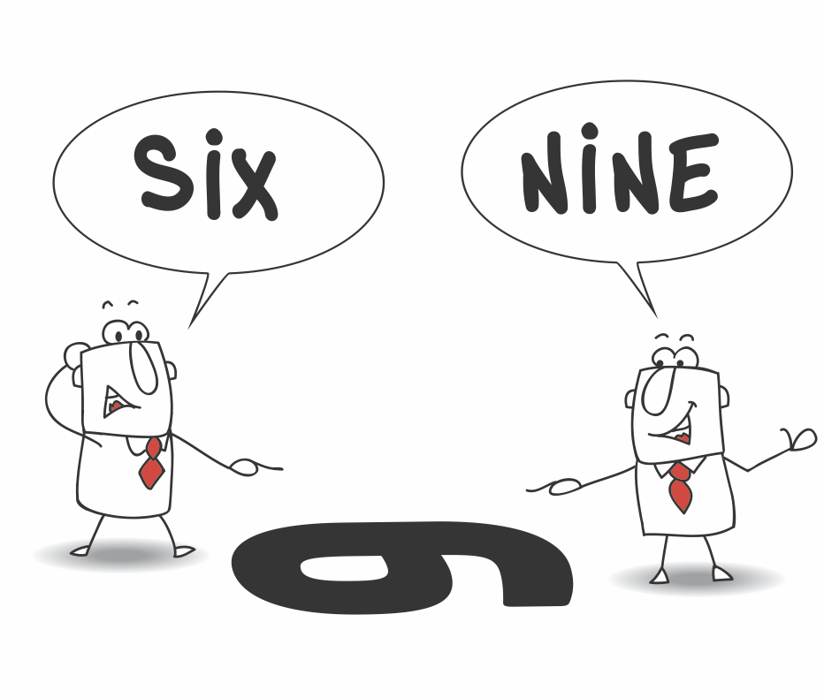
THIRD - FIFTH GRADE | EMPATHY
6 OR 9?
© 2022 OVERCOMING OBSTACLES

