Slide 1
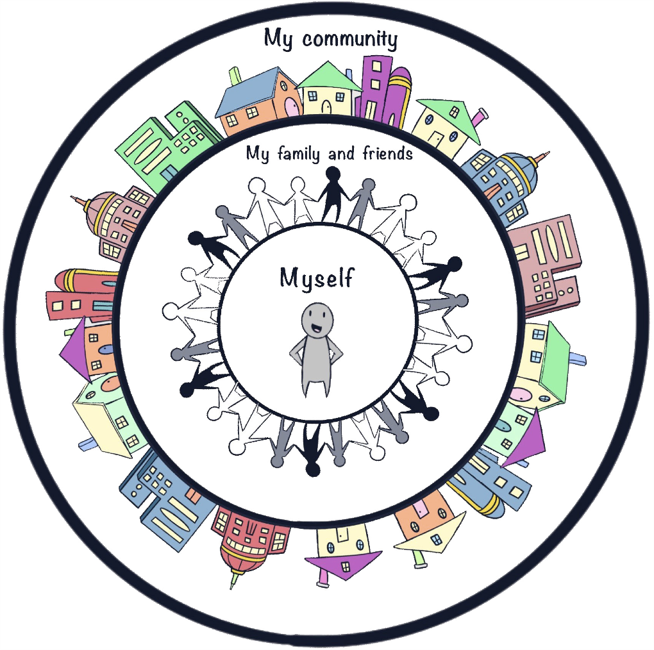
THIRD - FIFTH GRADE | BEING RESPONSIBLE
CIRCLES OF RESPONSIBILITY
© 2022 OVERCOMING OBSTACLES

