Slide 1
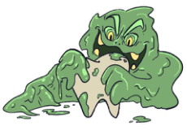
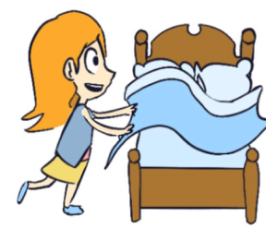
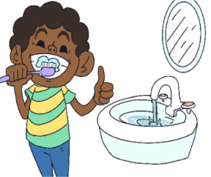
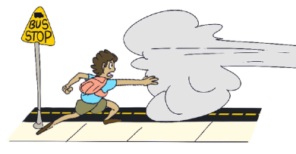
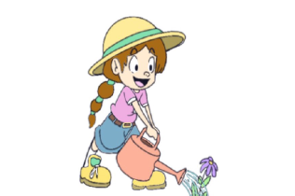
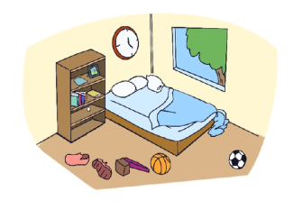
KINDERGARTEN - SECOND GRADE | BEING RESPONSIBLE
RESPONSIBILITIES AND CONSEQUENCES POSTER
Responsible Actions | Consequences/Problems
© 2022 OVERCOMING OBSTACLES

