Slide 1
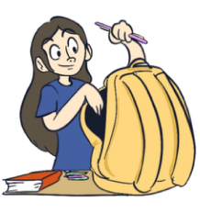
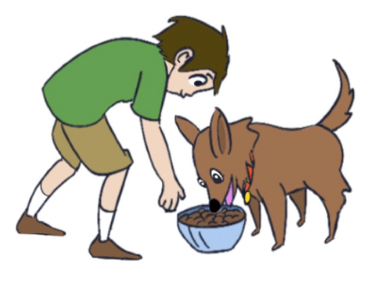
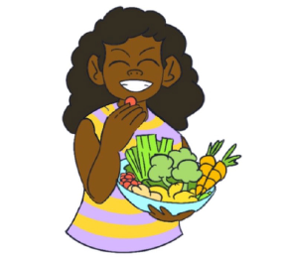
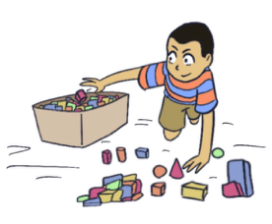
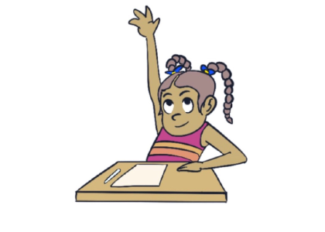
KINDERGARTEN - SECOND GRADE | BEING RESPONSIBLE
RESPONSIBILITIES OF STUDENTS
© 2022 OVERCOMING OBSTACLES

