Slide 1
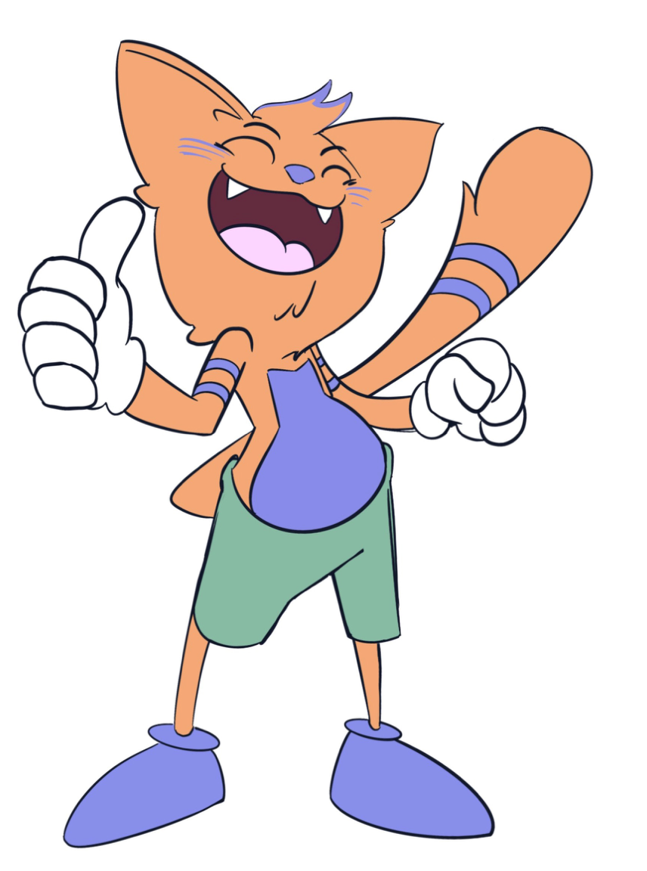
KINDERGARTEN - SECOND GRADE | INTEGRITY
GOOD CHOICE
© 2022 OVERCOMING OBSTACLES

