Slide 1
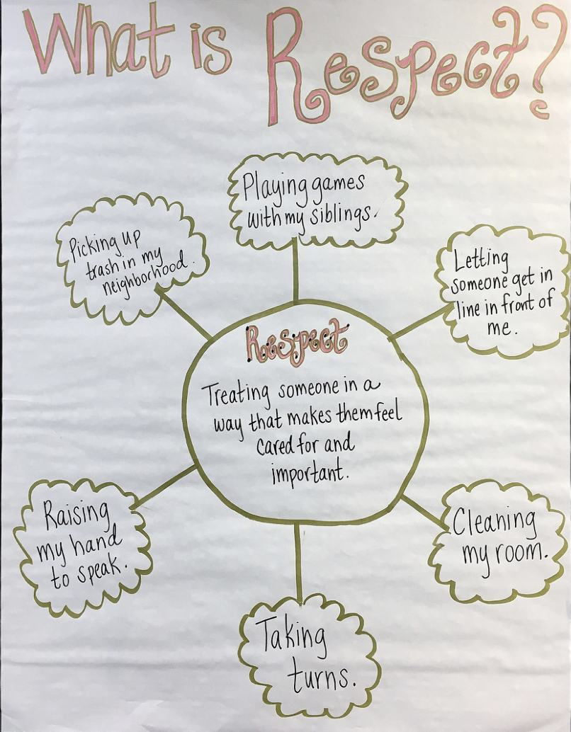
KINDERGARTEN - SECOND GRADE | RESPECT
RESPECT ANCHOR CHART
© 2022 OVERCOMING OBSTACLES

