Slide 1
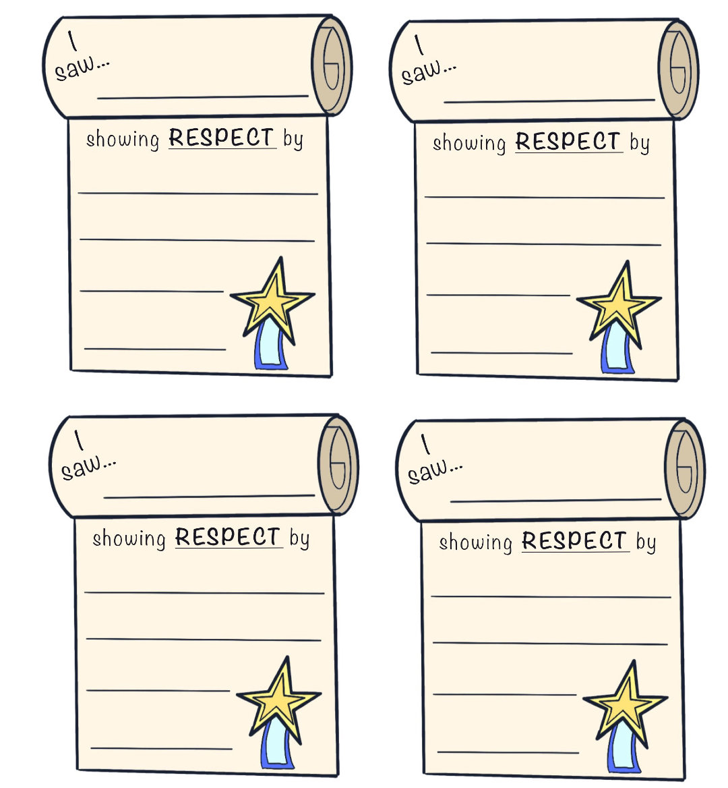
KINDERGARTEN - SECOND GRADE | RESPECT
RESPECT FORMS FOR JAR
© 2022 OVERCOMING OBSTACLES

