Slide 1
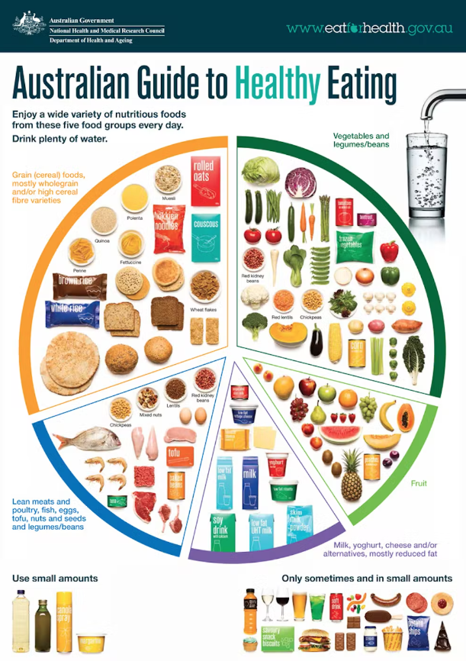
CONFIDENCE BUILDING | GIVING AND EARNING RESPECT
MyPlate
© 2022 OVERCOMING OBSTACLES

